Slide 1

UNDERSTANDING CAREER ASPIRATIONS OF GEN Z
Humera Shaik

Slide 2

Contents
1
3
5
7
Problem Statement
Data Cleaning and standardization
Data Analysis in SQL
Functional Dashboard in power BI
Developed a problem statement to explore and educate about the career aspirations of Gen-Z, addressing challenges and personal insights.
Loaded data dump into Excel, cleaning and exploring high- level information using Power Query Editor.
Conducted data analysis using SQL, solving complex questions with the help of Common Table Expressions (CTEs) and joins.
Developed three focused dashboards for each area, incorporating KPIs, Power Query Editor, measures, and groups in Power BI.
2
4
6
8
Data Collection
Exploratory Data Analysis
Executive Dashboard in Excel
Presentation
Created a Google Form with tailored questions to collect data on Gen-Z's career aspirations.
Created a Power BI dashboard summarizing Gen-Z's learning aspirations, mission aspirations, and manager aspirations.
Worked on an employer-focused project, creating recommendations and emphasizing the importance of storytelling in data.
Developed three dashboards on customer service, finance and orders in EXCEL

Slide 3
STAGE 1: PROBLEM STATEMENT

Slide 4

What is happening?
Meaningful work: They want jobs aligned with their values (sustainability, diversity, social justice).
Who is affected?
Financial security: While passion matters, they also seek stable income and career growth.
Gen Z (born between 1997-2012) is tech-savvy, purpose-driven, and values flexibility.
They prioritize mental well-being, work-life balance
and social impact.
They seek diverse, inclusive, and innovative work environments.
Entrepreneurial mindset: Many prefer freelancing, startups, and side hustles over traditional 9-to-5 jobs.
Continuous learning: They prioritize skill development, upskilling, and personal growth.

Slide 5

When is this happening?
Early exposure through internships, online courses, and side projects.
Rapid shifts in career choices, often
switching jobs within 2-3 years.
They embrace gig economy and remote work early in their careers.
Why is that happening?
Exposure to digital revolution and global connectivity.
Economic uncertainties push them toward
financial independence.
Influence of social media and peer success stories.
Desire for impact-driven careers that contribute to society.
Where is this happening?
Remote-first or hybrid work environments.
Global opportunities: They prefer flexibility to work from anywhere.
Tech-driven companies: Startups, AI, blockchain, and sustainable industries attract them.

Slide 6
STAGE 2: DATA COLLECTION

Slide 7
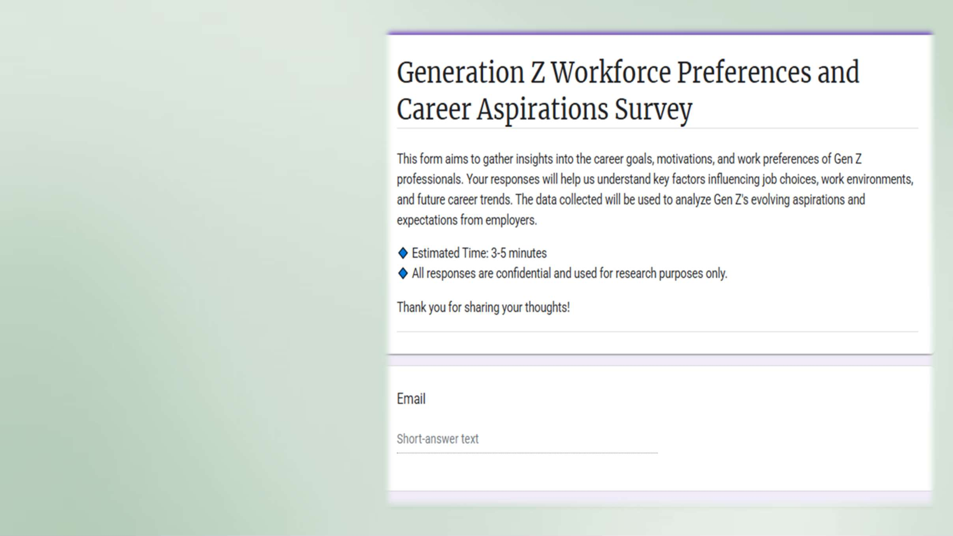
This form collects insights on Gen Z’s career goals, work preferences, and motivations. It helps understand their job expectations, preferred work environments, and future career trends. Responses are confidential and used for research purposes.
Estimated time: 3-5 minutes.

Slide 8
STAGE 3: DATA CLEANING
AND STANDARDIZATION

Slide 9

Data Cleaning & Standardization of Gen Z Career Aspirations Dataset in Excel
Remove Duplicates – Use Remove Duplicates to eliminate redundant responses.
Handle Missing Data – Fill blanks using mean/mode for numerical data or "N/A" for text fields.
Standardize Formats – Ensure consistency in date formats, text capitalization, and categorical responses.
Fix Inconsistencies – Use Find & Replace to correct typos and unify terms (e.g., "Remote" vs. "Work from Home").
Convert Data Types – Ensure numbers, dates, and text fields are correctly formatted.
Remove Outliers – Use Conditional Formatting to detect extreme values. 7.Categorize Data – Group responses into meaningful categories for analysis. This process ensures clean, accurate, and structured data for meaningful insights.

Slide 10

STAGE 4: EXPLORATORY DATA ANALYSIS

Slide 11

Exploratory Data Analysis (EDA) using Excel Pivot Tables helps uncover trends in Gen Z career aspirations by summarizing and visualizing key insights. By organizing data into pivot tables, we can analyze job preferences, salary expectations, and work flexibility choices. Aggregating responses by categories (e.g., industry preference, remote vs. hybrid work) allows for quick comparisons. Calculating averages, counts, and percentages helps identify dominant career trends. Pivot charts further enhance data visualization, making insights more accessible for decision- making.

Slide 12
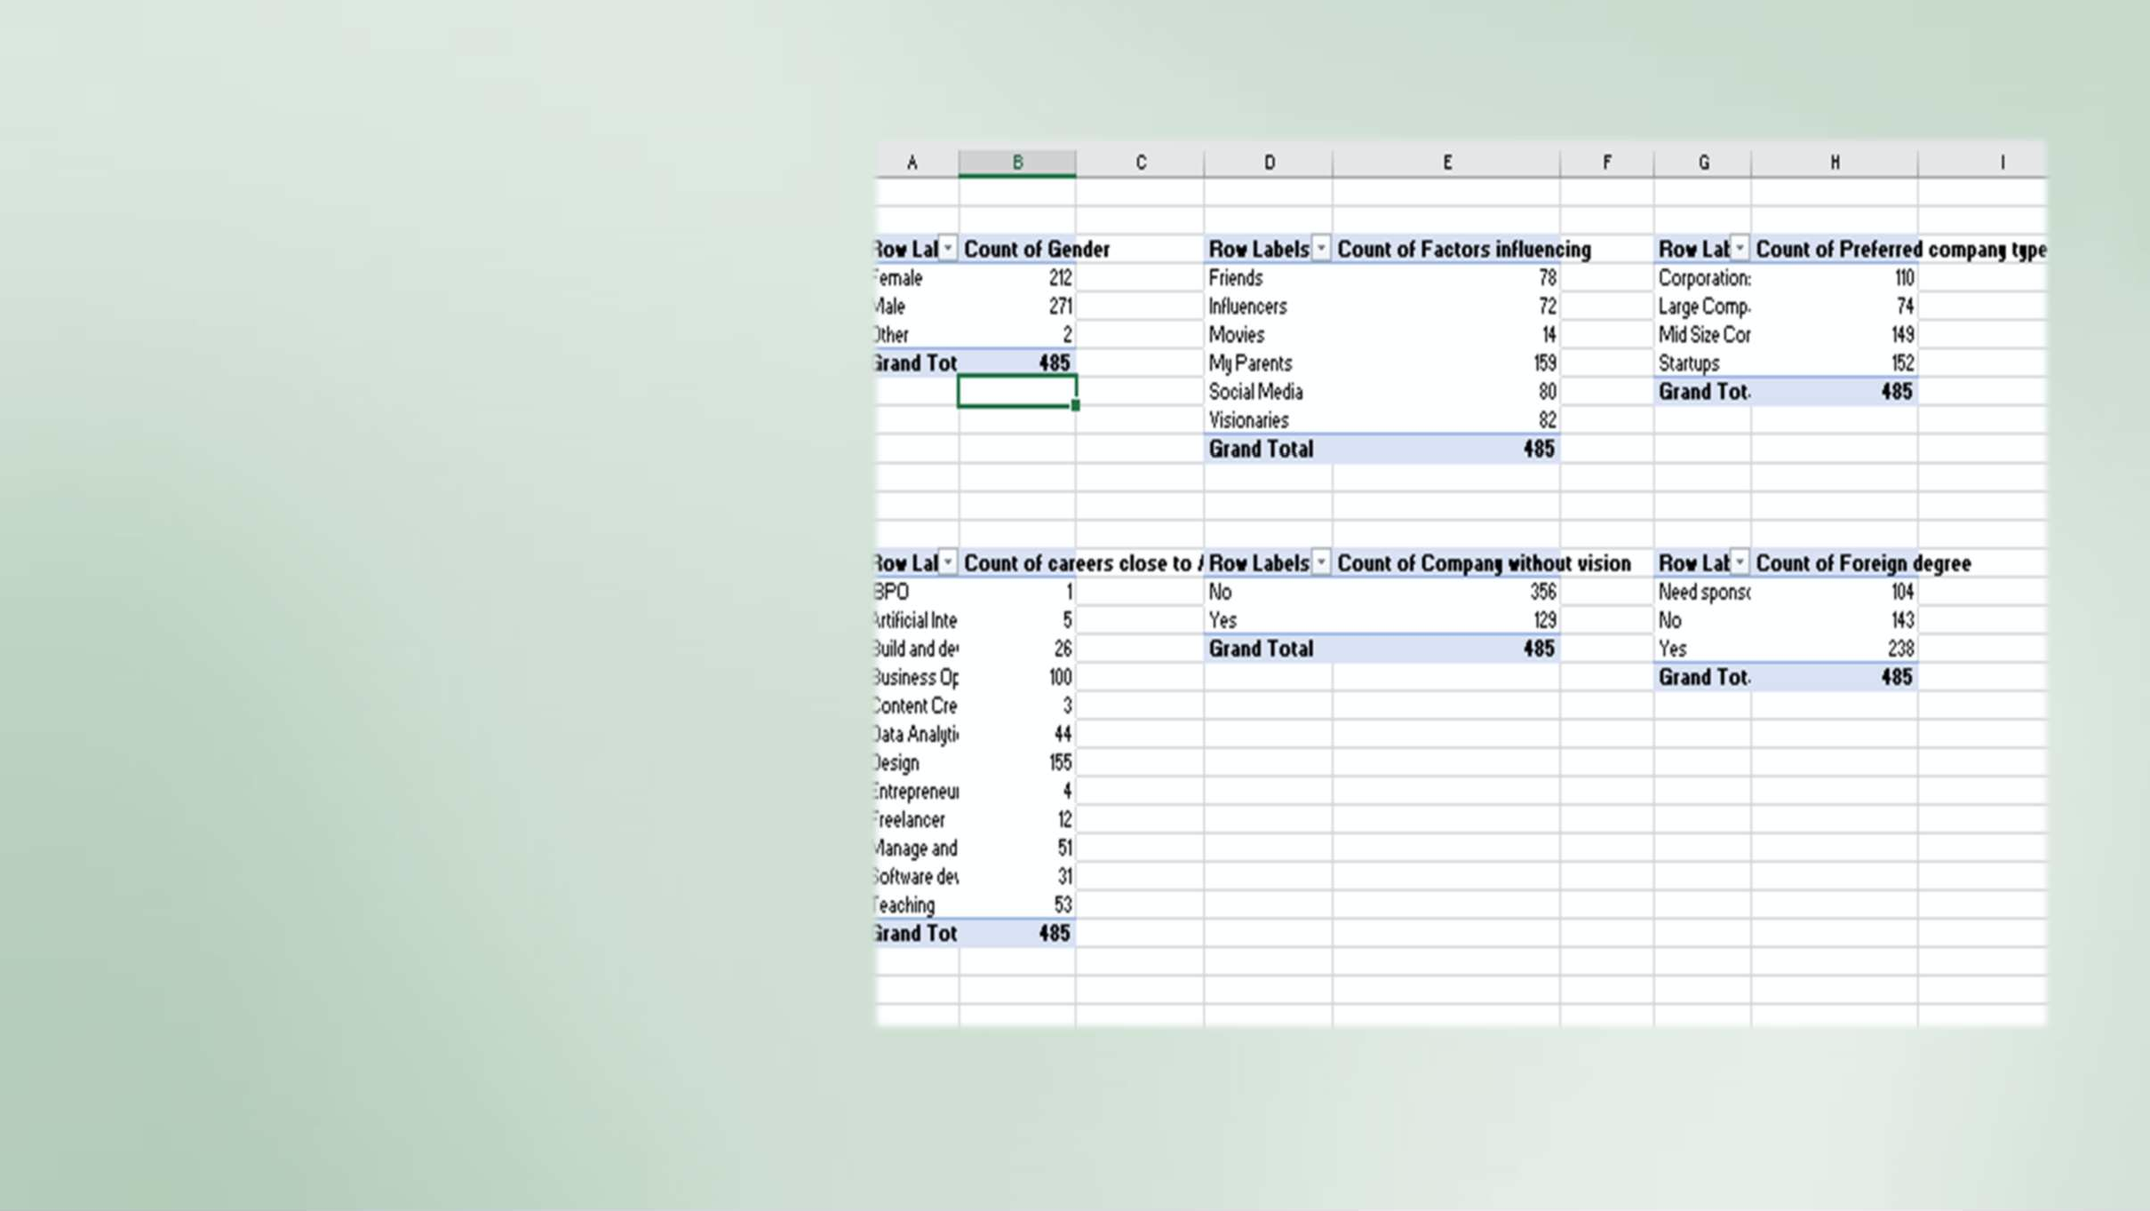
What is the gender distribution of respondents?
How does career aspiration vary by gender?
What are the top factors influencing career aspirations?
How many respondents are willing to stay in the same company for more than 3 years?
How does salary expectation vary based on experience?
What percentage of
respondents are interested in a foreign degree?
What are the most common frustrations at work?
What are the preferred working hours among respondents?

Slide 13
STAGE 5:
DATA ANALYSIS IN SQL

Slide 14
-- 1. What industries are Gen-Z most interested in pursuing careers in?
SELECT "Preferred company type", COUNT(*) as Count
FROM Career Aspirations Table GROUP BY "Preferred company type" ORDER BY Count DESC;
-- 2. What are the top factors influencing Gen-Z’s career choices?
SELECT "Factors influencing", COUNT(*) as Count FROM Career Aspirations Table
GROUP BY "Factors influencing" ORDER BY Count DESC;
-- 3. What is the desired work environment for Gen-Z? (e.g., remote, hybrid, in-office)
SELECT "working from office", COUNT(*) as Count FROM Career Aspirations Table
GROUP BY "working from office" ORDER BY Count DESC;

Slide 15

-- 4. How do financial goals, such as salary and benefits, impact career aspirations among Gen-Z?
SELECT "In Hand salary -3yrs exp", COUNT(*) as Count FROM Career Aspirations Table
GROUP BY "In Hand salary -3yrs exp" ORDER BY Count DESC;
-- 5. What role do personal values and social impact play in career choices for Gen-Z?
SELECT "What would make you happier and productive at work", COUNT(*) as Count
FROM Career Aspirations Table
GROUP BY "What would make you happier and productive at work"
ORDER BY Count DESC;

Slide 16
STAGE 6: EXCEL EXECUTIVE
DASHBOARD

Slide 17
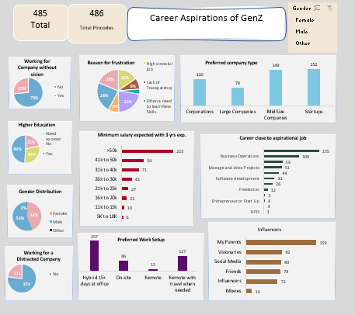

Slide 18
STAGE 7: POWER BI FUNCTIONAL
DASHBOARD

Slide 19
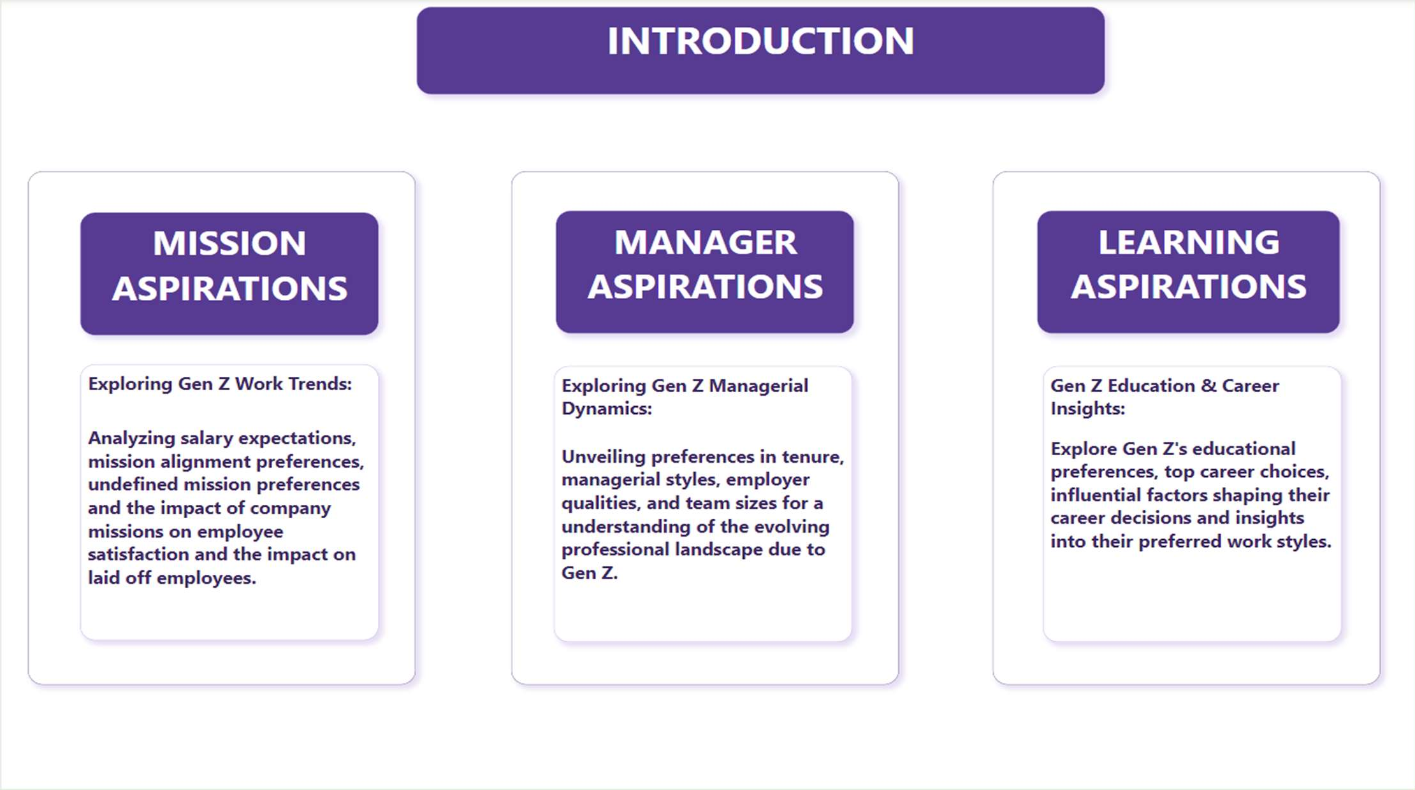

Slide 20
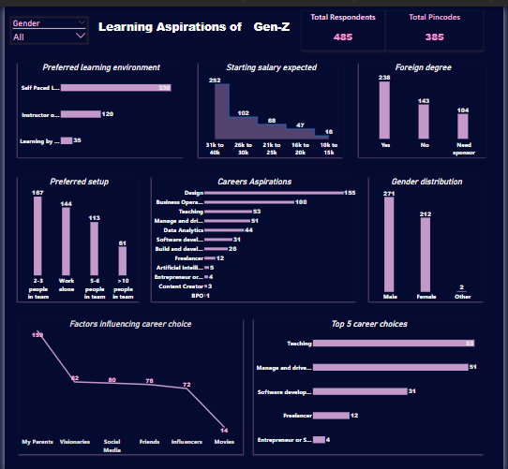

Slide 21
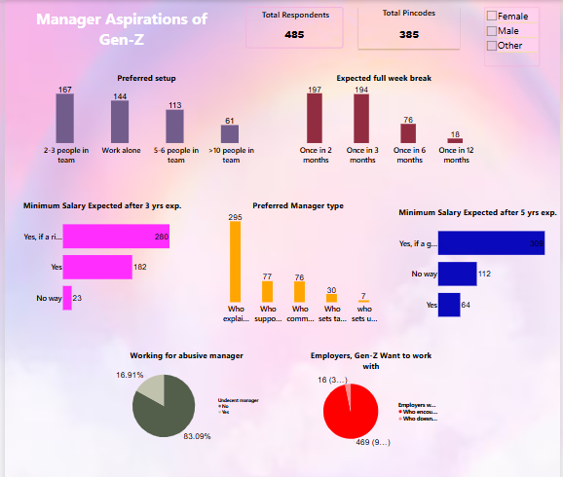

Slide 22
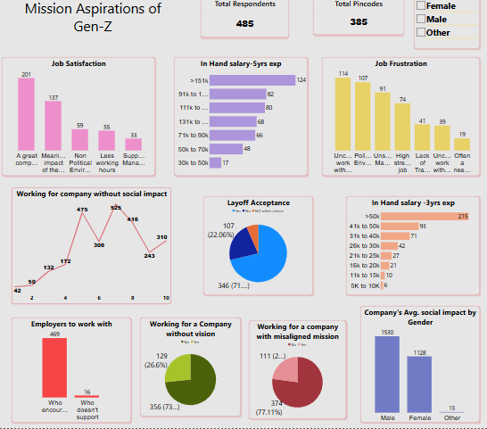

Slide 23

INSIGHTS

Slide 24
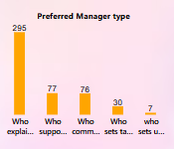
INSIGHTS
PROBLEM
Poor Managers or Leadership
RECOMMENDATIONS
Invest in leadership development programs
Implement a feedback system
Schedule regular meetings with the managers and teams to ensure open communication

Slide 25
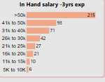
INSIGHTS
PROBLEM
Poor or Low Salaries
RECOMMENDATIONS
Conduct regular market research
Implement performance-based pay
Communicate openly about the company's financial situation
Enhance non-monetary benefits such as health insurance, flexible work hours or professional development opportunities

Slide 26
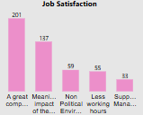
PROBLEM
INSIGHTS
No Job satisfaction
RECOMMENDATIONS
Flexible Work Options – Offer remote/hybrid work models to support work-life balance.
Career Growth & Learning – Provide continuous learning opportunities, mentorship, and clear career progression.
Fair Compensation & Benefits – Ensure competitive salaries, wellness programs, and financial stability.
Purpose-Driven Work – Align roles with social impact,
sustainability, and meaningful contributions.
Inclusive & Positive Work Culture – Foster diversity, mental health support, and transparent communication.
Use of Technology – Provide modern digital tools and
automation to enhance productivity

Slide 27



